Slide 1
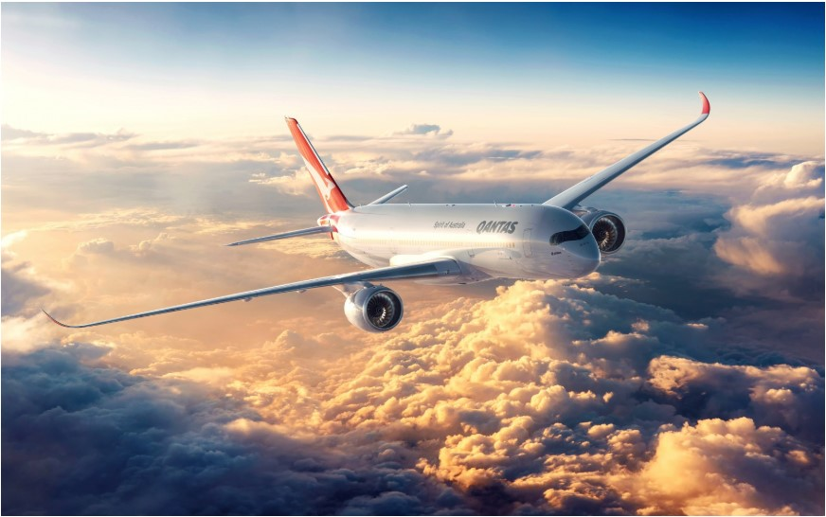
AIRLINE_RESERVATION_SYSTEM
Visualization Using Tableau and PowerBI
Team: Jarvis
Parin Shah
Sagar Shah
Mayank Mehta
Utkarsha Mahajan

Slide 2
4/8/2020 Flight Data
SUMMARY OF FLIGHT NUMBER AND STATUS
1/1
FlightNumber Status
N171US Delayed
N37300 Landed
N375VX Arrived
N3HYF9 No Takeoff Info
N3KUAA Departed
N3LAWN Cancelled
N407UA Departed
N527B6 Delayed
N547MQ Arrived
N584NK Departed
N635AS Diverted
N651CO Expected
N826DL In Air
N853HA Arrived
N958EV Cancelled
N171US First FlightNumber
N171US | Delayed
FlightNumber | Status
N37300 | Landed
FlightNumber | Status
N375VX | Arrived
FlightNumber | Status
N3HYF9 | No Takeoff Info
FlightNumber | Status

Slide 3
4/8/2020
Flight Number Analysis
FlightNumber CostPrice 
N3LAWN | 342.57
N547MQ | 340.14
N171US | 305.25
N375VX | 290.58
N584NK | 243.28
N958EV | 241.61
N651CO | 241.14
N826DL | 234.56
N3HYF9 | 231.46
N407UA | 230.24
N527B6 | 221.32
N853HA | 220.32
N3KUAA | 212.47
N37300 | 212.36
N635AS | 135.69
Total | 3,702.99
CostPrice by FlightNumber
N3LAWN N547MQ N171US N375VX N584NK N958EV
FlightNumber
0
50
100
150
200
250
300
350
CostPrice
CostPrice by FlightNumber
350
300
250
200
150
100
CostPrice
N3LAWN
N547MQ
N171US
N375VX
N584NK
N958EV
N651CO
N826DL
N3HYF9
N407UA
N527B6
N853HA
N3KUAA
N37300
N635AS
FlightNumber
1/1

Slide 4
4/8/2020
Member Analysis
FreeMiles by MemberType
9K
FreeMiles by MemberType
9K
MemberType | FreeMiles 
Gold | 8,234.84
Silver | 3,043.17
Bronze | 923.14
NA | 0.00
Total | 12,201.15
8K
8K
7K
7K
6K
6K
FreeMiles
5K
FreeMiles
5K
4K
4K
3K
3K
2K
2K
1K
1K
0K
Gold
Silver Bronze
MemberType
NA
0K
Gold
Silver Bronze
MemberType
NA
1/1

Slide 5
4/8/2020
Payment details
PaymentAmount by LastName
100%
PaymentAmount by FirstName
800
FirstName | LastName | PaymentAmount
Abel | Sanchez | 398.75
Art | Venere | 350.56
Cammy | Albares | 370.27
Donette | Foller | 326.34
Graciela | Ruta | 457.69
James | Travinsky | 741.25
Josephine | Darakjy | 570.36
Kiley | Calderra | 521.47
Kris | Marrier | 759.21
Lenna | Paprocki | 452.94
Leota | Dilliard | 370.56
Minna | Amigon | 542.51
Mitsue | Tollner | 670.56
Sage | Wieser | 558.69
Simona | Morasca | 750.36
Total |  | 7,841.52
Marrier
Morasca Travinsky Tollner Darakjy Wieser Amigon Calderra Ruta Paprocki Sanchez Dilliard Albares Venere Foller
759.21
750.36
700
741.25
600
670.56
570.36
500
558.69
PaymentAmount
542.51
400
521.47
457.69
300
452.94
398.75
200
370.56
370.27
100
350.56
0
326.34
Kris
James
Mitsue
Sage
Minna
Kiley
Lenna
Abel
Leota
Art
Simona
Josephine
Graciela
Cammy
Donette
43%
FirstName
1/1

Slide 6
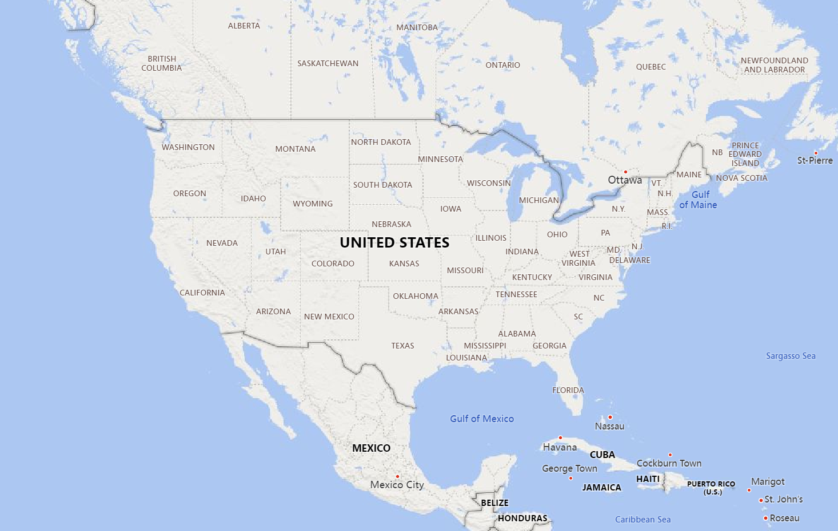


4/8/2020 Passenger City
1/1
City and LastName
LastName Albares
Amigon
Calderra
Darakjy
Dilliard
Foller
Marrier
Morasca
Paprocki
Ruta
Sanchez
Tollner
Travinsky
Venere
LastName City
Albares Boulder
Amigon Austin Calderra Providence Darakjy Boston
Dilliard Milwaukee
Foller Princeton
Marrier Amhearst Morasca Ashland Paprocki Portland Ruta Charlotte Sanchez Philadelphia Tollner Baltimore Travinsky San Jose Venere Chicago
Wieser Albany
© 2020 HERE, © 2020 Microsoft Corporation

Slide 7
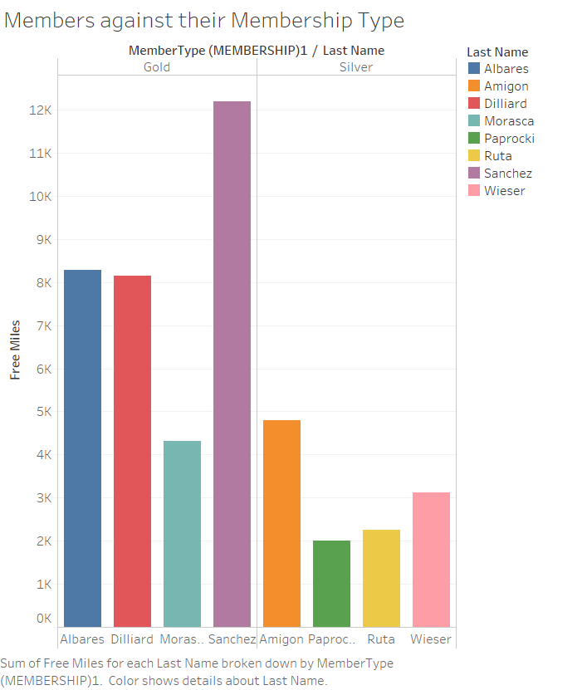

Slide 8
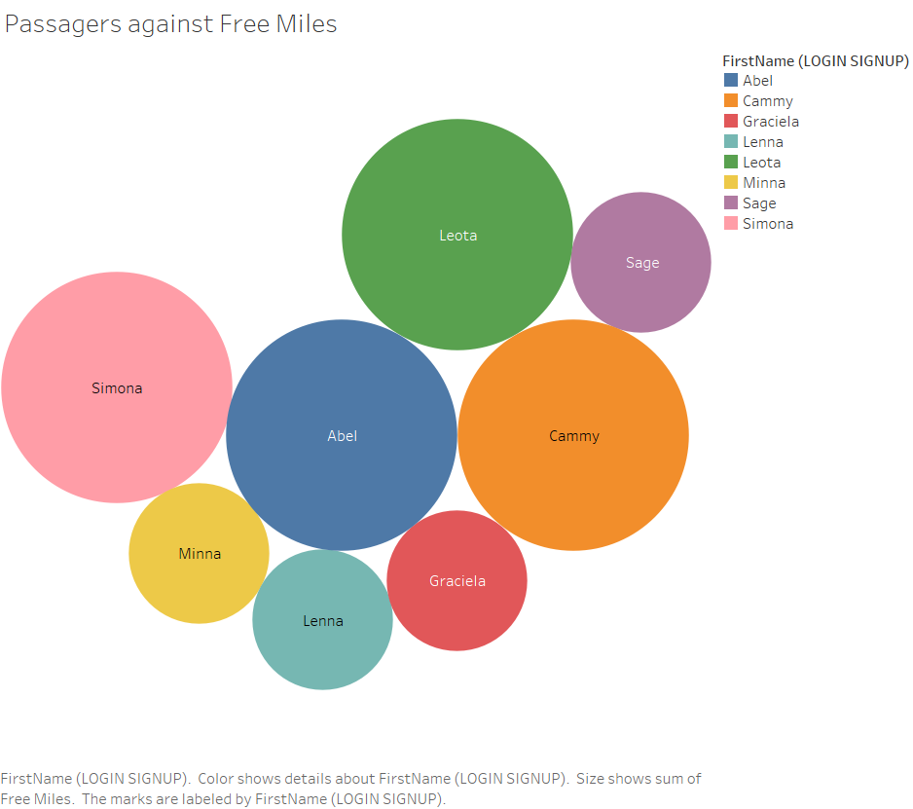

Slide 9
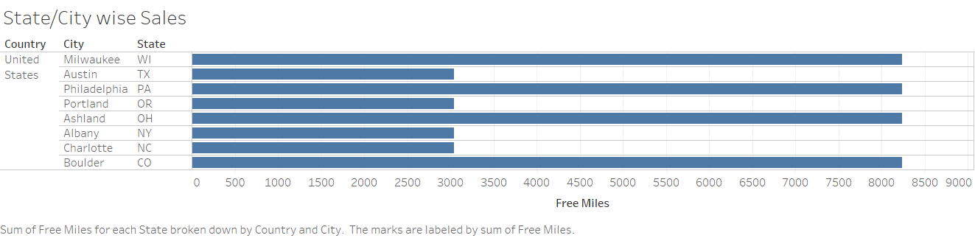

Slide 10
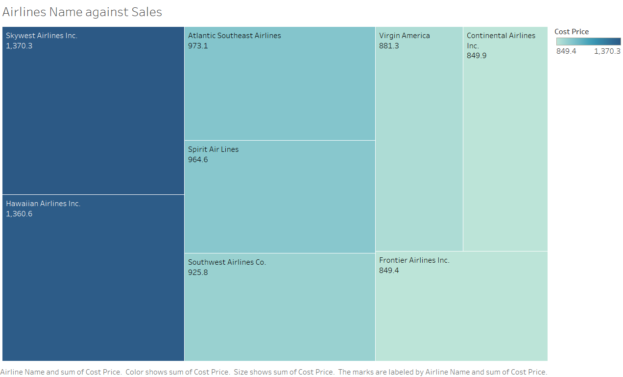

Slide 11
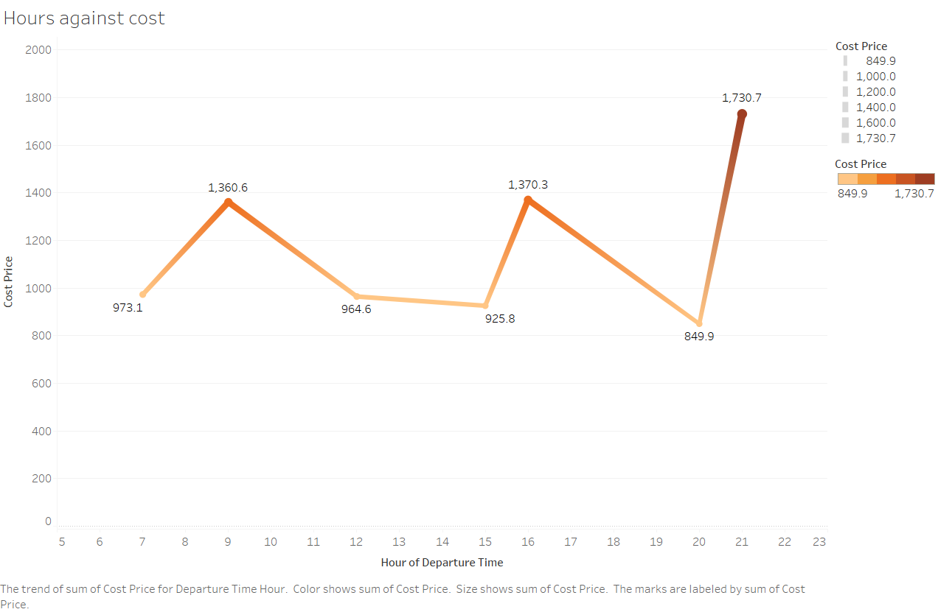

Slide 12
